Slide 1
WOPR: Batch histories

Slide 2
Problem:
wopr-ui batch history screen was not updating properly when Multi-Routing was used.
Cause:
Multi-Routing response is different from wopr response in that it
doesn’t contain the data needed to populate the history data

Slide 3
Solution:
Create a topic to feed shipment lines to the support api

Slide 4
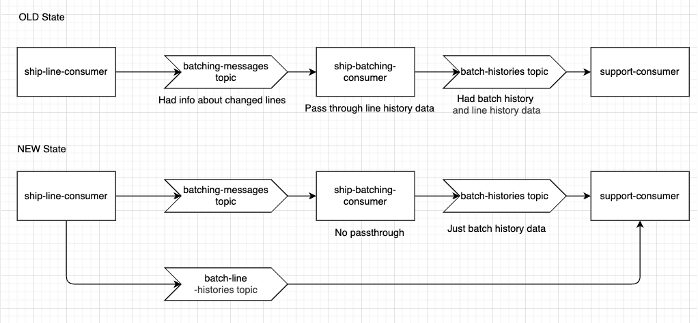

Slide 6
Changes needed:
Create new topic - Done
Update line-consumer to produce to this topic - Done
Restructure code in support consumer for the changes - Done
Remove the pass-through code in batch-consumer - Done
Deploy new app changes to prod - Done

Slide 7
Questions

Slide 8
Thank you

